Slide 1
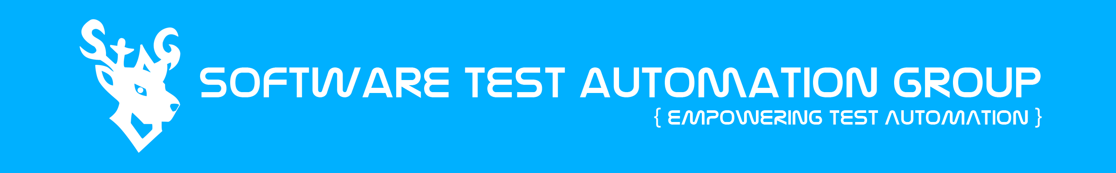
Software Test Automation Group (STAG)
Screenplay design pattern
By Matthew Chan

Slide 2
Agenda
Serenity-BDD Introduction
Traditional page objects
Breaking down page objects → Screenplay pattern
Screenplay pattern components
Screenplay demo against TodoMVC in AngularJS
Questions

Slide 3
Serenity-BDD/JS
An open source library whose goal is to make your automation test suite a living documentation
Also a full fledged automation framework
Wrapper on top of Selenium WebDriver/REST-API library
Integrates with existing test frameworks
Supports the page object & screenplay design pattern

Slide 4
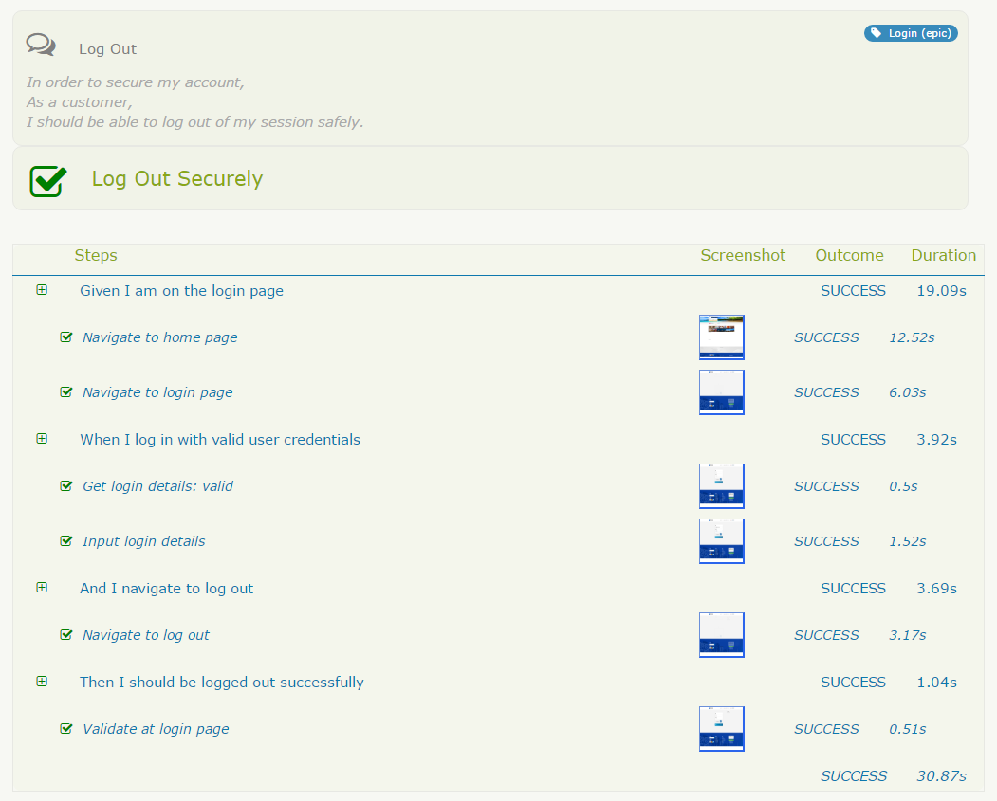
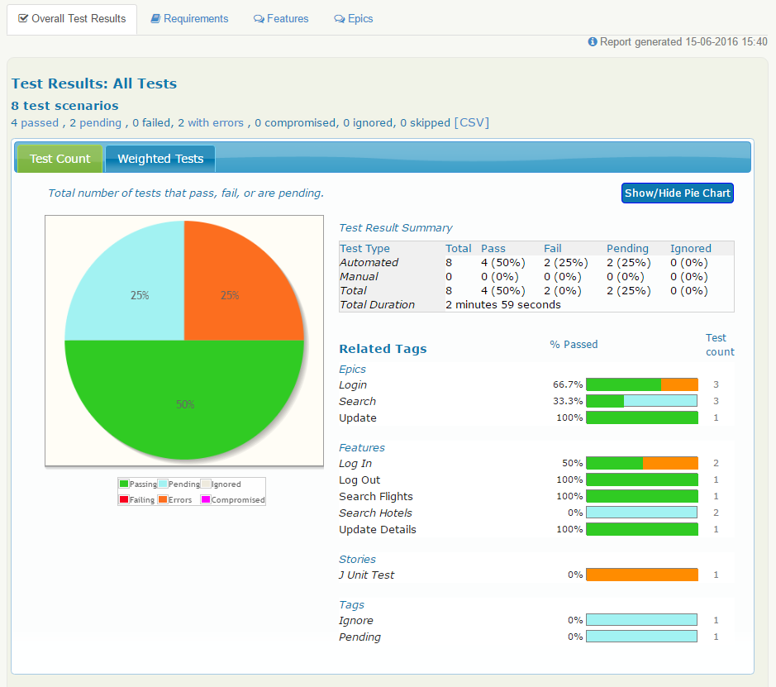
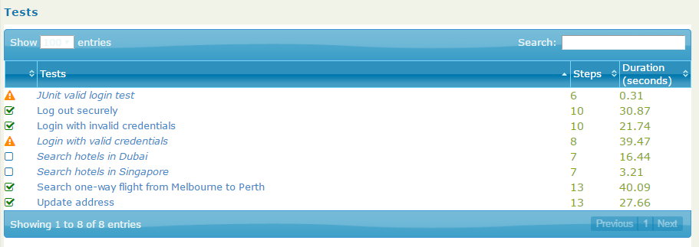
Serenity HTML Report

Slide 5
Serenity Step Library
Use multiple layers of abstraction to hide the complexity
Layer in between test and page objects
Separate the “what” from the “how”
Methods with the @Step annotation are recognized as a step library method
Step library classes are automatically instantiated with the use of the @Steps annotation
Adds additional reporting steps to the HTML report

Slide 6
Page objects
Page objects staple of automated web test frameworks using Selenium – from the WebDriver project.
Reduce maintenance issues and flaky tests (Not Selenium’s fault)
Simon Stewart talked of this in his article “My Selenium Tests aren’t Stable”when he said:
“Firstly, let’s state clearly: Selenium is not unstable, and your Selenium tests don’t need to be flaky. The same applies for your WebDriver tests. […] When your tests are flaky, do some root cause analysis to understand why they’re flaky. It’s very seldom because you’ve uncovered a bug in the test framework.”
WD enshrined PO’s, PO’s are not the best domain model to apply – why not investigate more design patterns? PO’s fine?

Slide 7
Page objects
Example of complex page object:
https://gist.github.com/RiverGlide/7718ab70f9d1ee0eddbf8bcf95887555
One approach is to not think of each page as an object representing a page – but objects within a page (widget & page component).
Should not think of what we’re developing in terms of “Pages”, it should be in terms of user stories and what they achieve when implemented.
What if workflow of of pages CHANGE?!

Slide 8
History of Journey/Screenplay pattern
Agile alliance functional testing tools workshop (AAFTT) 2007
2012-13 screenplay-JVM created
2015 screenplay pattern implemented into Serenity-BDD
2016 implemented into Serenity-JS

Slide 9
SOLID principles
Single Responsibility Principle
Open Closed Principle
Liskov Substitution Principle
Interface Segregation Principle
Dependency Inversion Principle
SRP: One responsibility & one reason to change
Reduces risk of affecting other unrelated behaviours
OCP: Class open for extension & closed for modification
Instead of appending to PO and facing code smells, it should be possible to add a new class that extends on PO.

Slide 10
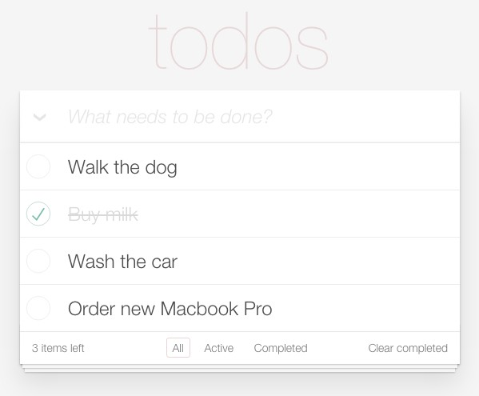
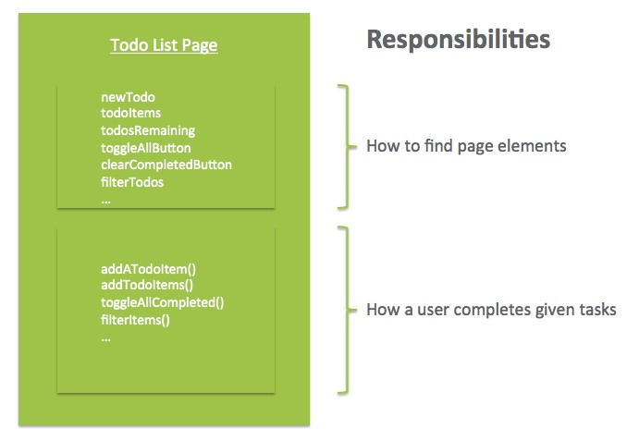
Breaking down page objects
Images taken from: https://dzone.com/articles/page-objects-refactored-solid-steps-to-the-screenp

Slide 11
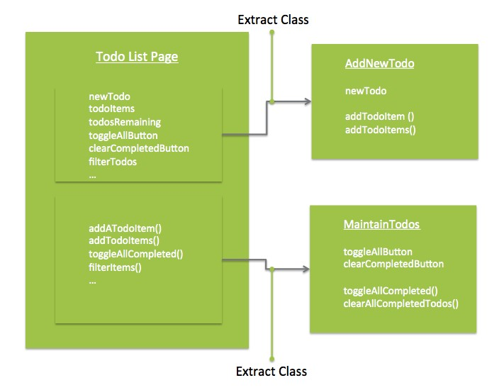
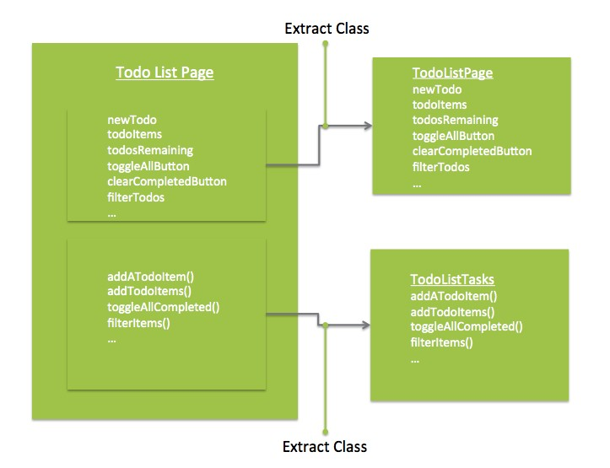
Breaking down page objects incorrectly
Break down by behaviours
Break down by responsibility
What if they share the same Web Element?
What if we want to add a new behaviour?
[X] OCP [ ] SRP
Images taken from: https://dzone.com/articles/page-objects-refactored-solid-steps-to-the-screenp
[ ] OCP [X] SRP

Slide 12
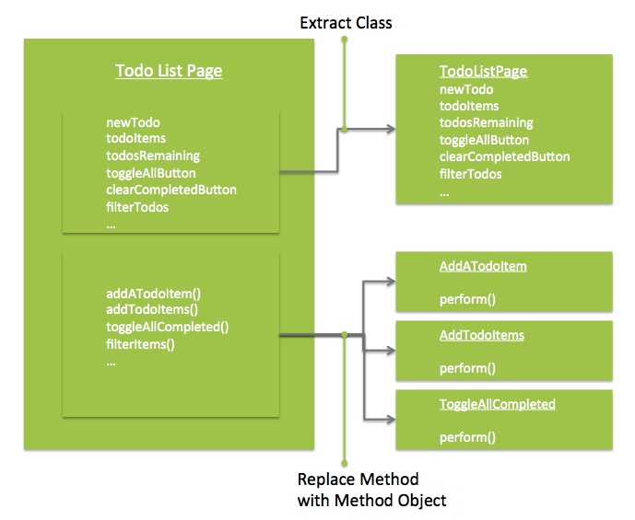
Page objects → Screenplay pattern
[X] OCP [X] SRP
New behaviours do not require you to modify existing classes
Each class only has one reason to change
Either element no longer works, or task no longer works.
Images taken from: https://dzone.com/articles/page-objects-refactored-solid-steps-to-the-screenp

Slide 13
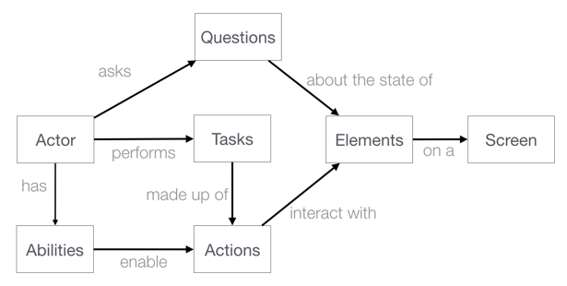
Screenplay pattern design overview
In UX design we break down by:
Goals – What user is trying to achieve in business terms
Tasks – high level steps user needs to perform this goal
Actions – how user interacts with the system
Behaviours drive our test.
This perspective + O.O = screenplay
Images taken from: https://dzone.com/articles/page-objects-refactored-solid-steps-to-the-screenp

Slide 14
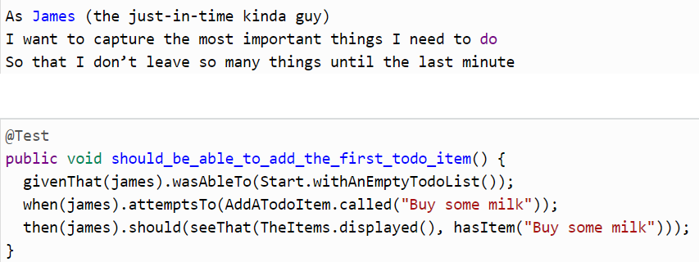
Screenplay - feature & scenario/test
ToDoMVC App
Goal: should_be_able_to_add_the_first_todo_item()
- Tests read better if they are presented in the point of view of the user

Slide 15

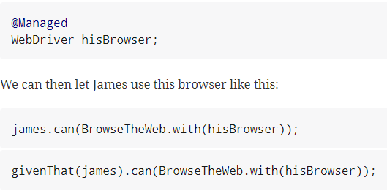
Screenplay - Roles
Role = Actor = Persona: It is the heart of the screenplay pattern
Actor
Has Abilities = Selenium/REST API
Tasks = Add the item to do
Actions = Interaction with App
Questions = Verify state of app

Slide 16
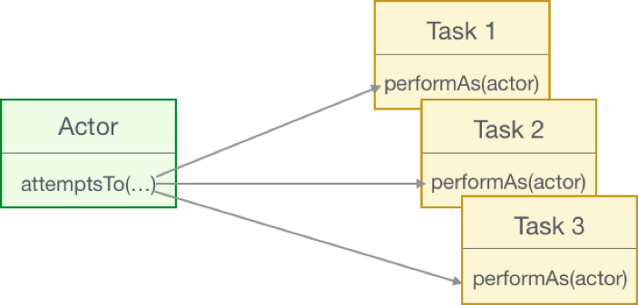
Screenplay - Tasks
To achieve our goal: add first to-do item
Actors perform tasks
Tasks are just objects that implement the Task interface and need to implement the special performAs(actor) method.
High level tasks can call lower level tasks or actions
Images taken from: https://dzone.com/articles/page-objects-refactored-solid-steps-to-the-screenp

Slide 17
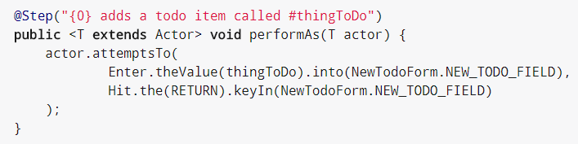
Screenplay - Actions
Action within Task class “AddATodoItem.java”
Serenity screenplay DSL predefined to describe common low-level UI interactions.

Slide 18

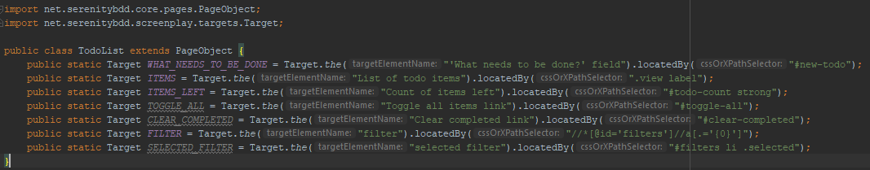
Screenplay – UI interfaces/page objects

Slide 19
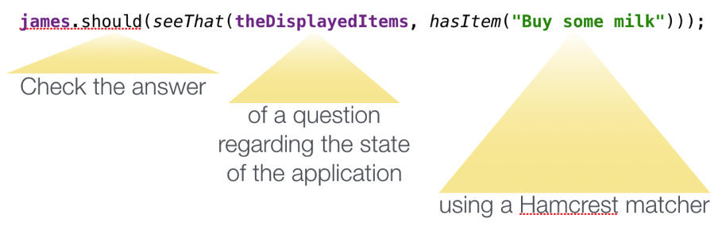
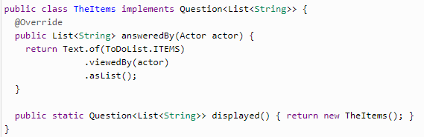
Screenplay - Questions
Typical automation test
Set up test data / app to known state
Perform an action
Verify result
Images taken from: https://dzone.com/articles/page-objects-refactored-solid-steps-to-the-screenp

Slide 20
Screenplay - Folder structure
Screenplay
Actions
Refresh
JSClick
Models
TodoStatusFilter
Pages
AppHomePage
TodoList
TodoListItem
Questions
DisplayedItems
ItemsLeft
Tasks
AddATodoItem
CompleteItem
FilterItems
Start
Page Object
Pages
AppHomePage
TodoPage
FilterPage
Models
TodoStatusFilter

Slide 21

Show working demo - ToDoMVC
ToDoMVC URL: http://todomvc.com/examples/angularjs/#/
Explain tests
Run tests
Show report

Slide 22

Questions?

Slide 23
Appendix
Serenity-BDD (JAVA)
http://thucydides.info/docs/serenity-staging/
Good Serenity screenplay pattern for UI test example (JAVA)
https://github.com/navvro/serenity-demo
Serenity-JS (JS)
http://serenity-js.org/
Screenplay pattern
https://dzone.com/articles/page-objects-refactored-solid-steps-to-the-screenp
http://testerstories.com/2016/06/screenplays-and-journeys-not-page-objects/

